Slide 1
Capstone 1: Data Exploration on Caravan Insurance

Slide 2
Needle in a Haystack
Purpose of this project
Seeking potential buyers of Caravan Insurance
Who and why they may be at least interested

Slide 3
Data
Source: https://www.kaggle.com/uciml/caravan-insurance-challenge
Variables
85 Variable
Categorical Variables problem

Slide 4
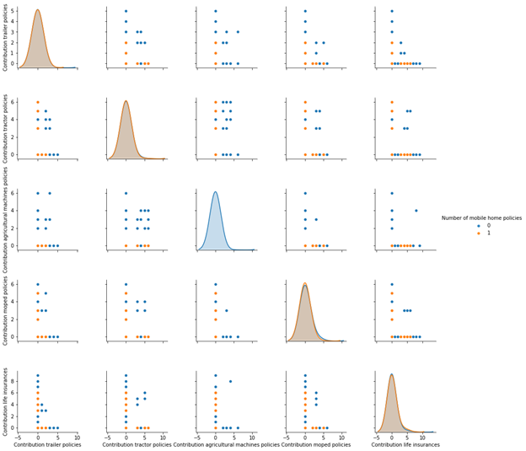
EDA
Pair Plot
The pair plot shows how 1 variable may or may not correlate with the other
When a variable paired with itself, the histogram is produced instead
The plot is showing groupings with observations with target variable = 0, in blue, or target variable = 1, in orange

Slide 5
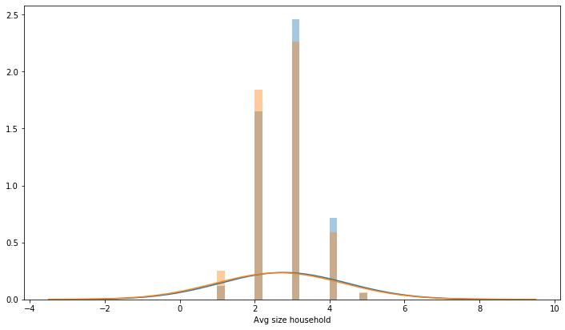
EDA
Histogram
Exploring data with histograms
Look closer by variable
Trying to see if visually there’s a noticeable difference those who have Caravan Insurance to those who don’t

Slide 6
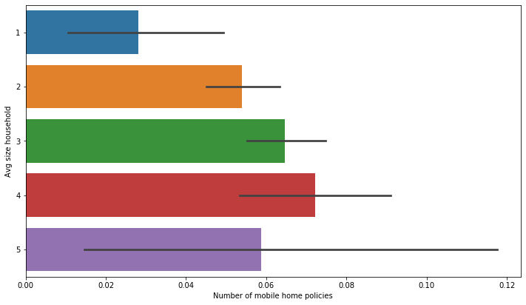
EDA
Bar Plot
Another perspective to explore data
Looking at the mean proportion to see if there’s a difference by class within a given variable

Slide 7
Statistical Inference
Chi Square test
Infer whether a variable has its mean estimate different from the overall mean
Bootstrap
Simulate the data and graphically represent

Slide 8
Machine Learning

